Slide 1
EECS 221A Project
Enze Zheng
Xiaoran Li
Xianpei Meng

Slide 2
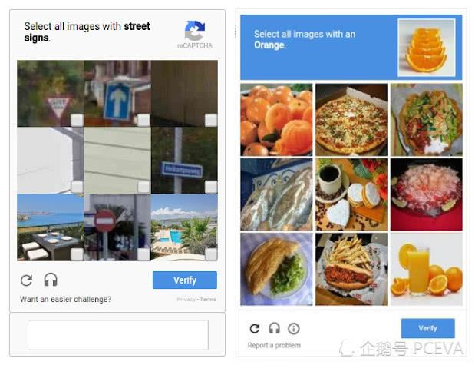
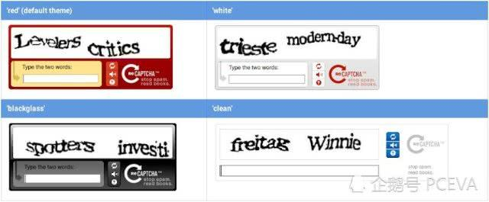
CAPTCHA
Prevent crawler to access web content
Sometimes, it is difficult for human to tell what it is

Slide 3
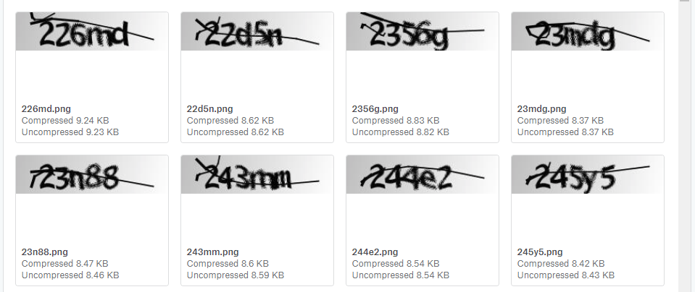

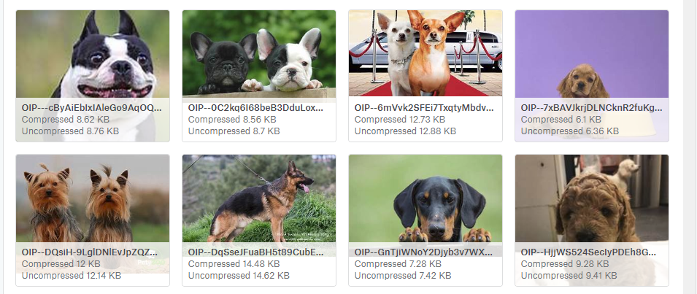
Machine Learning
1070 files with answer for supervised training
10 different kinds of animals
More than 20 thousands files in total

Slide 4
Related Work
Large-scale Artificial Neural Network: MapReduce-based Deep Learning(2015)
A Fundamental Tradeoff between Computation and Communication in Distributed Computing(2017)
Gradient Coding: Avoiding Stragglers in Distributed Learning(2017)

Slide 5
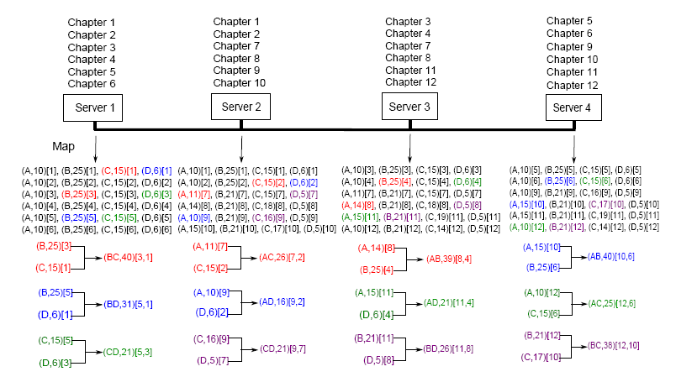
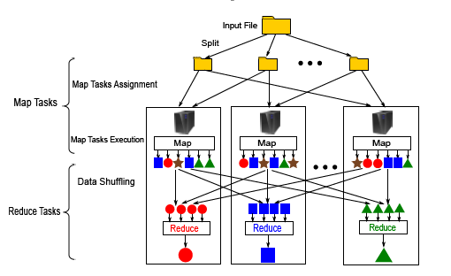
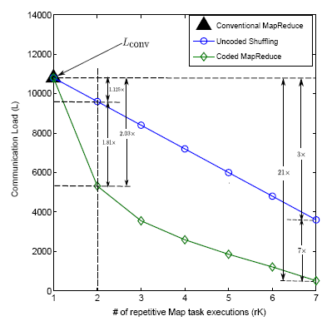
Coded MapReduce
Q:keys N:subfile
K:server pK:servers
Notes:
Save the communication cost, improve the performance for the training machine
Consider a job of using K servers to evaluate Q keys in an input file consisting of N subfiles, where each subfile is repetitively assigned to pK servers and is randomly and uniformly mapped at rK of those servers for some
The minimum communication load L(r) is bounded as

Slide 6
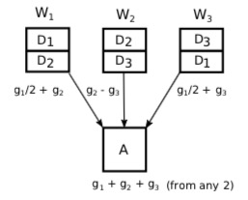
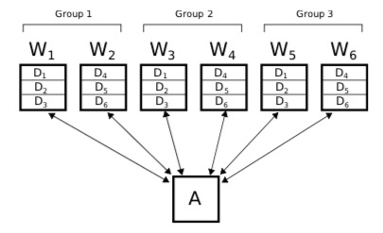

Gradient Coding

